Slide 1

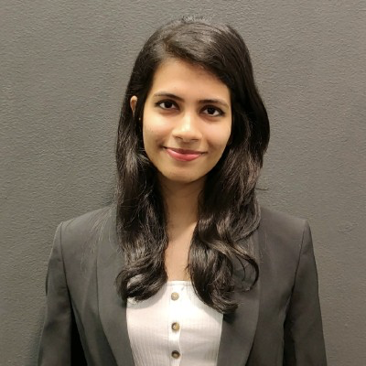

Project Pretzel
Sayli Karnik
SRE intern, Oracle RDBMS
August 2020

Slide 2
Why?
Current daily schema-change patch deployment scenario:
Engineering Team commits sql files to scm repository
Creates DATAOPS jira ticket requesting deploy to EI and prod
On-call SRE confirms manager approval in DATAOPS tickets, and consolidates them into 1 CM ticket/day
Oracle SRE manually logs into multiple Golden gate hosts and stops processes
Oracle SRE checks out patch files, uses a cli utility to apply patch files.
Oracle SRE restarts Golden Gate processes on hosts
This process needs automation for fast, effective and effortless schema change rollouts for databases.
.
Notes:
Current daily schema-change patch deployment process happens to be a cumbersome one with many human touchpoints and manual intervention. This process needs automation for fast, effective and effortless schema change rollouts for databases.

Slide 3
What?
A one-stop portal to deploy DML/DDL changes to remote Oracle Databases at Linkedin!
Orchestrates schema evolution on staging and production environments
Built as a Python web-app multi-product
It’s self-service (Patch needs to be reviewed by Oracle-SRE)
Abstracts complex workflows

Slide 4
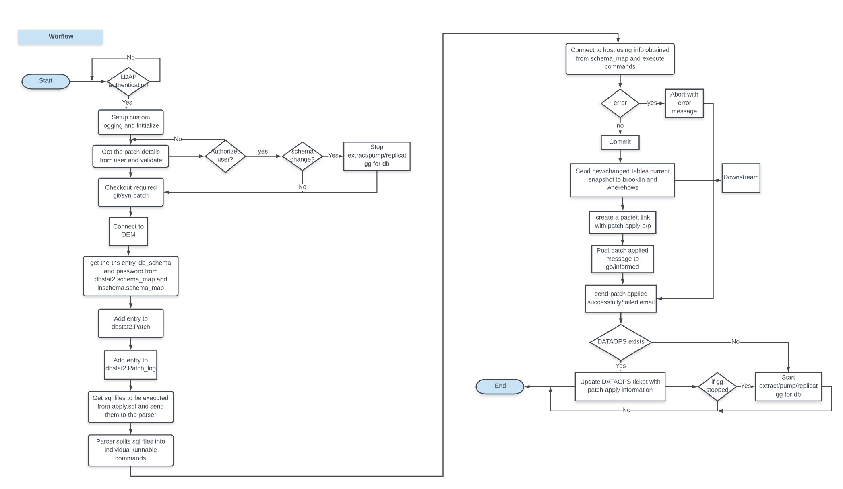
How?

Slide 5
Features
Secure user authentication+authorization
Patch review process by Oracle Team
Minimal effort by user (most info is retrieved from Review Board)
Automated SCM checkouts
Golden Gate replication across 3 COLOs done automatically
Maintains audit log for every deployment
Patch outcome via email and a paste-it link
Can Rollback patches easily
Sends changes to Kafka consumers for downstream consumption

Slide 6
Demo

Slide 7
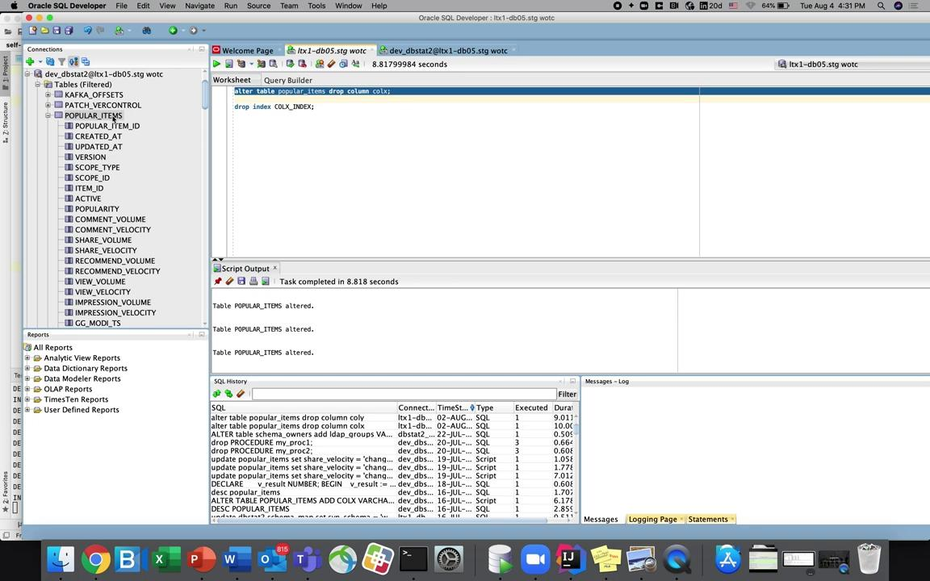

Slide 8
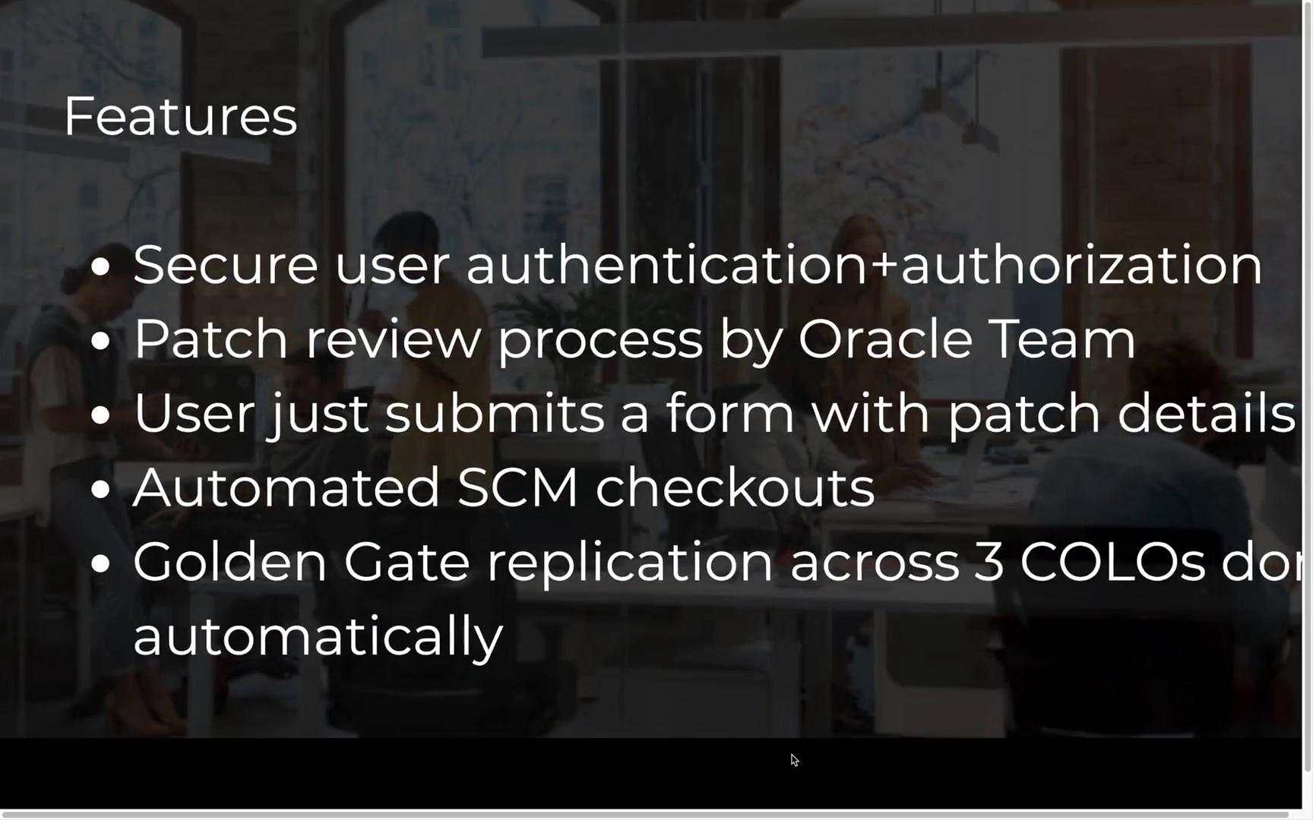

Slide 9
Impact
R
E
D
U
C
E
D
Toil
I
N
C
R
E
A
S
E
D
Productivity
Human Touchpoints
Faster CI/CD
Dependency on Oracle SREs
Ease of use
Wait times
Member satisfaction
24 * 7 DEPLOYMENTS made possible!
Notes:
Will have a sizeable impact on multiple teams.

Slide 10
Risks and Mitigations
Risk | User story | Mitigation
Outages | Human error by Developer | Thorough review process by SRE, Rollback option available
Schema locks | Multiple users might patch schema/restart GG simultaneously | Queueing of requests

Slide 11

Q/A
Wiki - go/pretzel
Repository - https://git.corp.linkedin.com:1367/plugins/gitiles/multiproducts/self-service-oradb
Progress report - go/skarnik
Slack channel - #dba
The office, season 8

